Slide 1
Project Name :Heart failure prediction
Name- Vikram Pratap Singh
Master in Data Science- Guvi
Email – sify.vikram@gmail.com

Slide 2
Problem Understanding
Determine disease of people from the dataset.
Various causes of heart diseases.

Slide 3
Solution
Linear Regression model.
Train test split.
Splitting the data into four category:
Feature_testing
Feature_training
Target_training
Target_testing

Slide 4
Goal of the project
To come at conclusion for cause of heart failure rate.
Analyze the model and get accuracy above 80%.

Slide 5
Benefit from the project:
Ability to check heart failure from machine learning from different techniques.

Slide 6
EDA
Univariate analysis - Pie chart
Bivariate analysis – Scatter plot
Multivariate - Heatmap

Slide 7
Diagnosis Analysis
Data Collection
Data analysis
Data Cleaning
Learning
Monitoring
Decision

Slide 8






Model Comparison
Logistic Regression
Decision Tree
Random Forest
Naïve Bayes
KNN
SVM

Slide 9
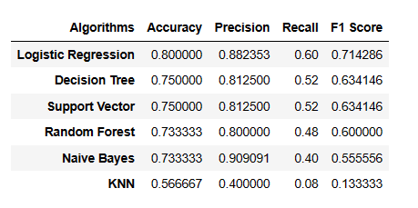
Predictive analysis

Slide 10
Prescriptive Analysis
The people with habit of smoking has more chances of heart failure.
The ages of heart failure disease is between 45 years to 75 years.

